Slide 1


Chapter 6 Basics of Finite Difference
OUTLINE
6.1 Components of Numerical Methods
6.2 Introduction to Finite Difference
6-3 Errors Involved in Numerical Solutions
6-4 Example

Slide 2
6.1 Components of numerical methods (3) Discretization methods (Finite Difference)-1
First step in obtaining a numerical solution is to discretize the geometric domain→ to define a numerical grid
Each node has one unknown and need one algebraic equation, which is a relation between the variable value at that node and those at some of the neighboring nodes.
The approach is to replace each term of the PDE at the particular node by a finite-difference approximation.
Numbers of equations and unknowns must be equal
6-3

Slide 3
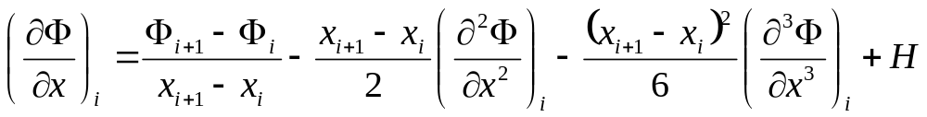
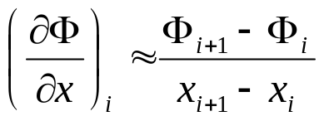
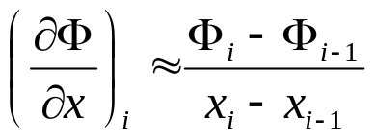
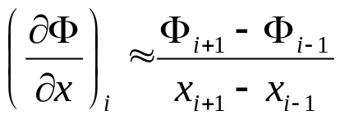
6.1 Components of numerical methods (4)
Discretization methods (Finite Difference)-2
Taylor Series Expansion: Any continuous differentiable function, in the vicinity of x_{i} , can be expressed as a Taylor series:
Higher order derivatives are unknown and can be dropped when the distance between grid points is small.
By writing Taylor series at different nodes, x_{i-1}, x_{i+1}, or both x_{i-1} and x_{i+1}, we can have:
Forward-FDS
Backward-FDS
1st order, order of accuracy P_{kest}=1
Central-FDS
2nd order, order of accuracy P_{kest}=1
6-4

Slide 4
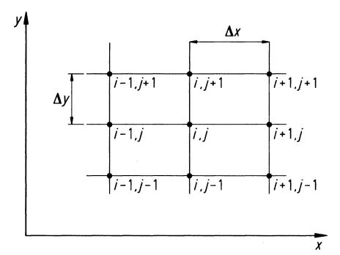
6-2 Introduction to Finite Difference (1)
Numerical solutions can give answers at only discrete points in the domain, called grid points.
If the PDEs are totally replaced by a system of algebraic equations which can be solved for the values of the flow-field variables at the discrete points only, in this sense, the original PDEs have been discretized. Moreover, this method of discretization is called the method of finite differences.
6-5

Slide 5

6-2 Introduction to Finite Difference (2)
A partial derivative replaced with a suitable algebraic difference quotient is called finite difference. Most finite-difference representations of derivatives are based on Taylor’s series expansion.
Taylor’s series expansion:
Consider a continuous function of x, namely, f(x), with all derivatives defined at x. Then, the value of f at a location can be estimated from a Taylor series expanded about point x, that is,
In general, to obtain more accuracy, additional higher-order terms must be included.
6-6

Slide 6
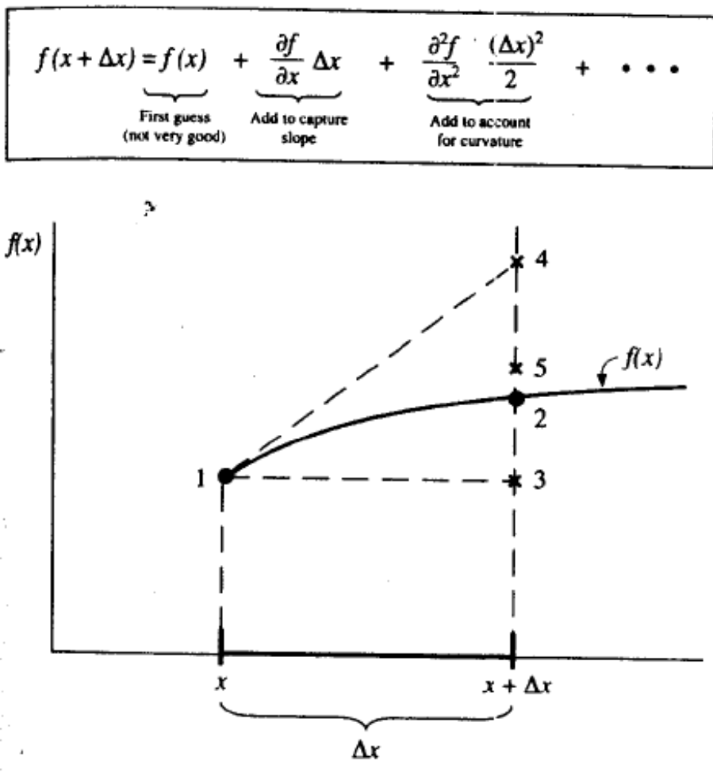
6-2 Introduction to Finite Difference (3)
6-7

Slide 7
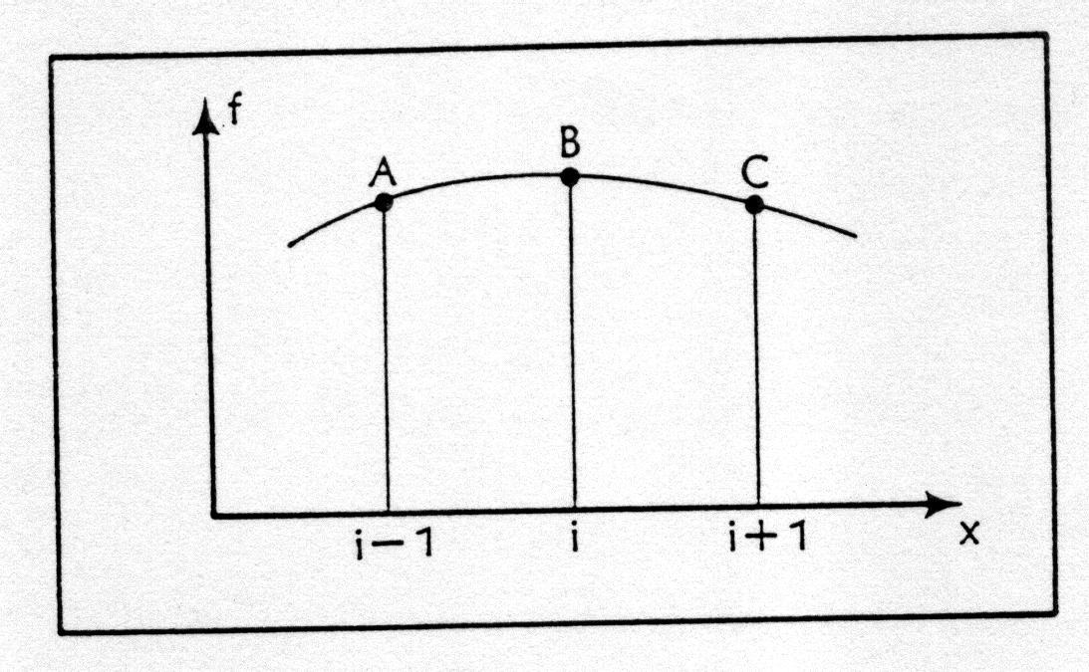
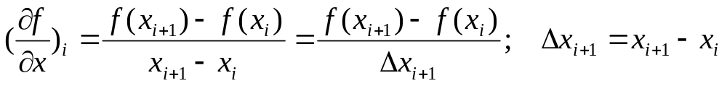
6-2 Introduction to Finite Difference (4)
• Forward, Backward and Central Differences:
(1) Forward difference:
Neglecting higher-order terms, we can get
(a)
6-8

Slide 8
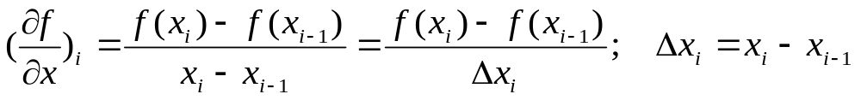
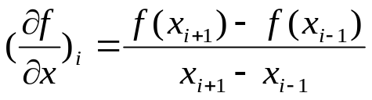
6-2 Introduction to Finite Difference (5)
(2) Backward difference:
Neglecting higher-order terms, we can get
(3) Central difference:
(a)-(b) and neglecting higher-order terms, we can get
(b)
…(c)
6-9

Slide 9

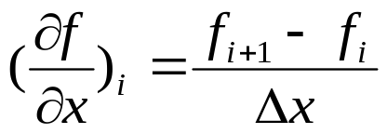
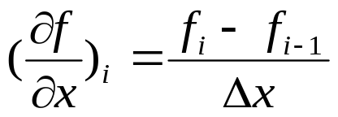
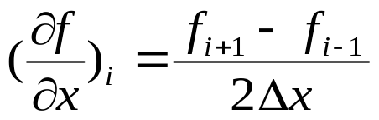
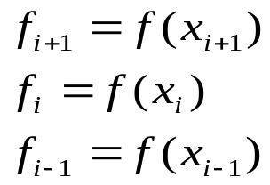
6-2 Introduction to Finite Difference (6)
(4) If , then (a), (b), (c) can be expressed as
Forward:
Backward:
Central:
Note:
…(d)
…(e)
…(f)
6-10

Slide 10
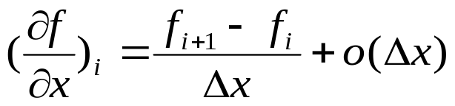
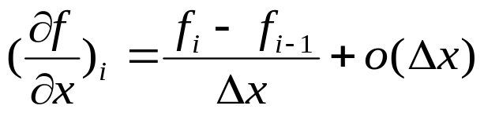
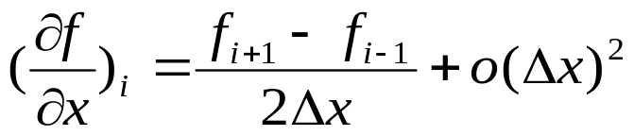
6-2 Introduction to Finite Difference (7)
Truncation error:
The higher-order term neglecting in Eqs. (a), (b), (c) constitute the truncation error. The general form of Eqs. (d), (e), (f) plus truncated terms can be written as
Forward:
Backward:
Central:
6-11

Slide 11
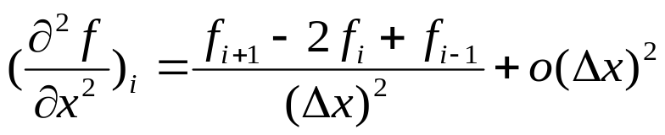
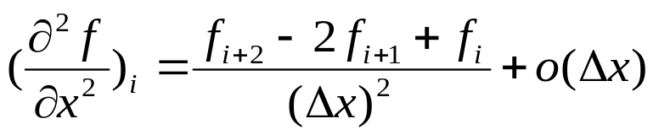
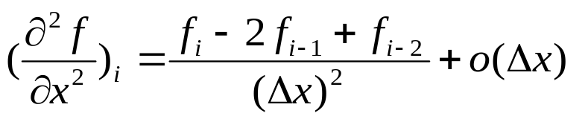
6-2 Introduction to Finite Difference (8)
Second derivatives:
* Central difference:
If , then (a)+(b) becomes
* Forward difference:
* Backward difference:
6-12

Slide 12
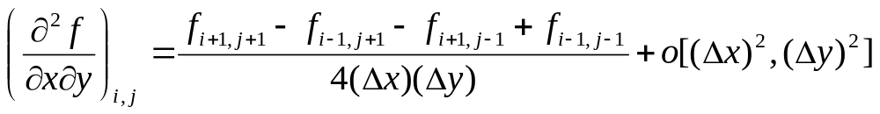
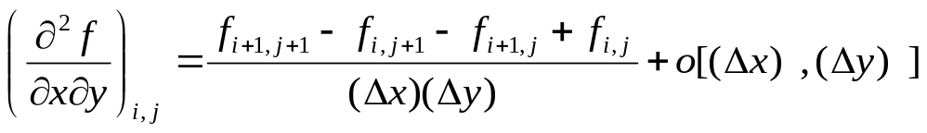
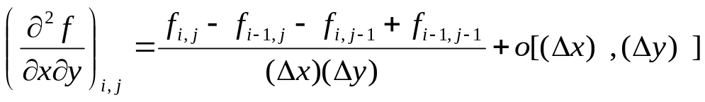
6-2 Introduction to Finite Difference (9)
Mixed derivatives:
* Taylor series expansion:
* Central difference:
* Forward difference:
* Backward difference:
6-13

Slide 13
6-3 Errors Involved in Numerical Solutions (1)
In the solution of differential equations with finite differences, a variety of schemes are available for the discretization of derivatives and the solution of the resulting system of algebraic equations.
In many situations, questions arise regarding the round-off and truncation errors involved in the numerical computations, as well as the consistency, stability and the convergence of the finite difference scheme.
Round-off errors:computations are rarely made in exact arithmetic. This means that real numbers are represented in “floating point” form and as a result, errors are caused due to the rounding-off of the real numbers. In extreme cases such errors, called “round-off” errors, can accumulate and become a main source of error.
6-23

Slide 14
6-3 Errors Involved in Numerical Solutions (2)
Truncation error: In finite difference representation of derivative with Taylor’s series expansion, the higher order terms are neglected by truncating the series and the error caused as a result of such truncation is called the “truncation error”.
The truncation error identifies the difference between the exact solution of a differential equation and its finite difference solution without round-off error.
6-24

